Slide 1
Transparent References and Garbage Collection for Project Darkstar
– making it easier to write applications on Project Darkstar Server
Esko Luontola
Programmer, UI Designer
www.orfjackal.net

Slide 2
Agenda
How Darkstar's persistence model is currently?
How transparent references and garbage collection change the persistence model?
Future directions

Slide 3
Agenda
How Darkstar's persistence model is currently?
How transparent references and garbage collection change the persistence model?
Future directions

Slide 4
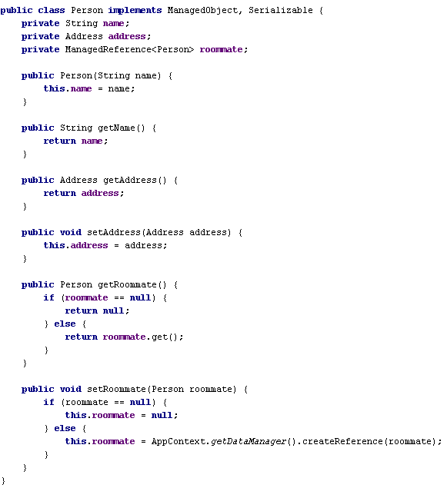
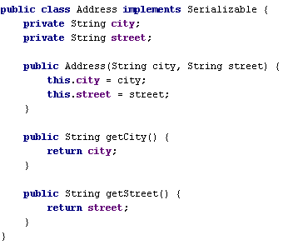
Darkstar requires special
handling for ManagedObjects

Slide 5
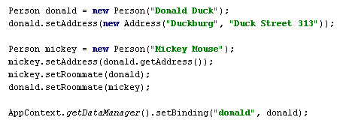
What happens under the hood when the following is executed?

Slide 6
Memory
Database

Slide 7
BEGIN TRANSACTION
Memory
Transaction
Database

Slide 8
Person donald = new Person("Donald Duck");
Memory
Transaction
Person
name = “Donald Duck”
Database

Slide 9
donald.setAddress(new Address("Duckburg", "Duck Street 313"));
Memory
Transaction
Person
name = “Donald Duck”
Address
city = “Duckburg”
street = “Duck Street 313”
address
Database

Slide 10
Person mickey = new Person("Mickey Mouse");
Memory
Transaction
Person
name = “Donald Duck”
Address
city = “Duckburg”
street = “Duck Street 313”
address
Person
name = “Mickey Mouse”
Database

Slide 11
mickey.setAddress(donald.getAddress());
Memory
Transaction
Person
name = “Donald Duck”
Address
city = “Duckburg”
street = “Duck Street 313”
address
address
Person
name = “Mickey Mouse”
Database

Slide 12
mickey.setRoommate(donald);
mickey.roommate = AppContext.getDataManager().createReference(donald);
Memory
Transaction
id = 1
Address
city = “Duckburg”
street = “Duck Street 313”
Person
name = “Donald Duck”
address
address
ManagedReference
id = 1
roommate
Person
name = “Mickey Mouse”
Database
id = 1

Slide 13
donald.setRoommate(mickey);
donald.roommate = AppContext.getDataManager().createReference(mickey);
Memory
Transaction
id = 1
Address
city = “Duckburg”
street = “Duck Street 313”
Person
name = “Donald Duck”
address
roommate
address
ManagedReference
id = 1
roommate
ManagedReference
id = 2
id = 2
Person
name = “Mickey Mouse”
Database
id = 1
id = 2

Slide 14
AppContext.getDataManager().setBinding("donald", donald);
Memory
Transaction
id = 1
Address
city = “Duckburg”
street = “Duck Street 313”
Person
name = “Donald Duck”
address
roommate
address
ManagedReference
id = 1
roommate
ManagedReference
id = 2
id = 2
Person
name = “Mickey Mouse”
Database
id = 1
id = 2
“donald” = 1

Slide 15
COMMIT TRANSACTION
Memory
Transaction
id = 1
Address
city = “Duckburg”
street = “Duck Street 313”
Person
name = “Donald Duck”
address
roommate
address
ManagedReference
id = 1
roommate
ManagedReference
id = 2
id = 2
Person
name = “Mickey Mouse”
Write
Database
Person
name = “Donald Duck”
id = 1
id = 2
Address
city = “Duckburg”
street = “Duck Street 313”
ManagedReference
id = 2
“donald” = 1

Slide 16
COMMIT TRANSACTION
Memory
Transaction
id = 1
Address
city = “Duckburg”
street = “Duck Street 313”
Person
name = “Donald Duck”
address
roommate
address
ManagedReference
id = 1
roommate
ManagedReference
id = 2
id = 2
Person
name = “Mickey Mouse”
Write
Database
Person
name = “Donald Duck”
id = 1
id = 2
Person
name = “Mickey Mouse”
Address
city = “Duckburg”
street = “Duck Street 313”
Address
city = “Duckburg”
street = “Duck Street 313”
ManagedReference
id = 2
ManagedReference
id = 1
“donald” = 1

Slide 17

Memory
Person
name = “Donald Duck”
Address
city = “Duckburg”
street = “Duck Street 313”
address
roommate
address
ManagedReference
id = 1
roommate
ManagedReference
id = 2
Person
name = “Mickey Mouse”
Database
Person
name = “Donald Duck”
id = 1
id = 2
Person
name = “Mickey Mouse”
Address
city = “Duckburg”
street = “Duck Street 313”
Address
city = “Duckburg”
street = “Duck Street 313”
ManagedReference
id = 2
ManagedReference
id = 1
“donald” = 1

Slide 18
Memory
Database
Person
name = “Donald Duck”
id = 1
id = 2
Person
name = “Mickey Mouse”
Address
city = “Duckburg”
street = “Duck Street 313”
Address
city = “Duckburg”
street = “Duck Street 313”
ManagedReference
id = 2
ManagedReference
id = 1
“donald” = 1

Slide 19
Memory
Database
Person
name = “Donald Duck”
id = 1
id = 2
Person
name = “Mickey Mouse”
Address
city = “Duckburg”
street = “Duck Street 313”
Address
city = “Duckburg”
street = “Duck Street 313”
ManagedReference
id = 2
ManagedReference
id = 1
“donald” = 1

Slide 20
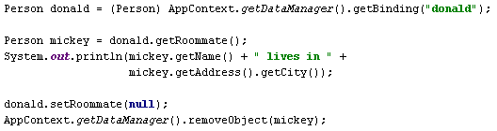
What happens under the hood when the following is executed?

Slide 21
Memory
Database
Person
name = “Donald Duck”
id = 1
id = 2
Person
name = “Mickey Mouse”
Address
city = “Duckburg”
street = “Duck Street 313”
Address
city = “Duckburg”
street = “Duck Street 313”
ManagedReference
id = 2
ManagedReference
id = 1
“donald” = 1

Slide 22
BEGIN TRANSACTION
Memory
Transaction
Database
Person
name = “Donald Duck”
id = 1
id = 2
Person
name = “Mickey Mouse”
Address
city = “Duckburg”
street = “Duck Street 313”
Address
city = “Duckburg”
street = “Duck Street 313”
ManagedReference
id = 2
ManagedReference
id = 1
“donald” = 1

Slide 23
Person donald = (Person) AppContext.getDataManager().getBinding("donald");
Memory
Transaction
Address
city = “Duckburg”
street = “Duck Street 313”
id = 1
address
Person
name = “Donald Duck”
roommate
ManagedReference
id = 2
Load
Database
Person
name = “Donald Duck”
id = 1
id = 2
Person
name = “Mickey Mouse”
Address
city = “Duckburg”
street = “Duck Street 313”
Address
city = “Duckburg”
street = “Duck Street 313”
ManagedReference
id = 2
ManagedReference
id = 1
“donald” = 1

Slide 24
Person mickey = donald.getRoommate();
Person mickey = donald.roommate.get();
Memory
Transaction
Address
city = “Duckburg”
street = “Duck Street 313”
id = 1
address
Person
name = “Donald Duck”
roommate
Address
city = “Duckburg”
street = “Duck Street 313”
ManagedReference
id = 1
roommate
address
ManagedReference
id = 2
id = 2
Person
name = “Mickey Mouse”
Load
Database
Person
name = “Donald Duck”
id = 1
id = 2
Person
name = “Mickey Mouse”
Address
city = “Duckburg”
street = “Duck Street 313”
Address
city = “Duckburg”
street = “Duck Street 313”
ManagedReference
id = 2
ManagedReference
id = 1
“donald” = 1

Slide 25
System.out.println(mickey.getName() + " lives in " +
mickey.getAddress().getCity());
Memory
Transaction
Address
city = “Duckburg”
street = “Duck Street 313”
id = 1
address
Person
name = “Donald Duck”
roommate
Address
city = “Duckburg”
street = “Duck Street 313”
ManagedReference
id = 1
roommate
address
ManagedReference
id = 2
id = 2
Person
name = “Mickey Mouse”
Database
Person
name = “Donald Duck”
id = 1
id = 2
Person
name = “Mickey Mouse”
Address
city = “Duckburg”
street = “Duck Street 313”
Address
city = “Duckburg”
street = “Duck Street 313”
ManagedReference
id = 2
ManagedReference
id = 1
“donald” = 1

Slide 26
donald.setRoommate(null);
Memory
Transaction
Address
city = “Duckburg”
street = “Duck Street 313”
id = 1
address
Person
name = “Donald Duck”
Address
city = “Duckburg”
street = “Duck Street 313”
ManagedReference
id = 1
roommate
address
ManagedReference
id = 2
id = 2
Person
name = “Mickey Mouse”
Database
Person
name = “Donald Duck”
id = 1
id = 2
Person
name = “Mickey Mouse”
Address
city = “Duckburg”
street = “Duck Street 313”
Address
city = “Duckburg”
street = “Duck Street 313”
ManagedReference
id = 2
ManagedReference
id = 1
“donald” = 1

Slide 27
AppContext.getDataManager().removeObject(mickey);
Memory
Transaction
Address
city = “Duckburg”
street = “Duck Street 313”
id = 1
address
Person
name = “Donald Duck”
Address
city = “Duckburg”
street = “Duck Street 313”
ManagedReference
id = 1
roommate
address
ManagedReference
id = 2
Person
name = “Mickey Mouse”
Database
Person
name = “Donald Duck”
id = 1
id = 2
Person
name = “Mickey Mouse”
Address
city = “Duckburg”
street = “Duck Street 313”
Address
city = “Duckburg”
street = “Duck Street 313”
ManagedReference
id = 2
ManagedReference
id = 1
“donald” = 1

Slide 28
COMMIT TRANSACTION
Memory
Transaction
Address
city = “Duckburg”
street = “Duck Street 313”
id = 1
address
Person
name = “Donald Duck”
Write
Address
city = “Duckburg”
street = “Duck Street 313”
ManagedReference
id = 1
roommate
address
ManagedReference
id = 2
Person
name = “Mickey Mouse”
Database
Person
name = “Donald Duck”
id = 1
id = 2
Person
name = “Mickey Mouse”
Address
city = “Duckburg”
street = “Duck Street 313”
Address
city = “Duckburg”
street = “Duck Street 313”
ManagedReference
id = 1
“donald” = 1

Slide 29
COMMIT TRANSACTION
Memory
Transaction
Address
city = “Duckburg”
street = “Duck Street 313”
id = 1
address
Person
name = “Donald Duck”
Address
city = “Duckburg”
street = “Duck Street 313”
ManagedReference
id = 1
roommate
address
ManagedReference
id = 2
Person
name = “Mickey Mouse”
Database
Person
name = “Donald Duck”
id = 1
Delete
Address
city = “Duckburg”
street = “Duck Street 313”
“donald” = 1

Slide 30
Memory
Address
city = “Duckburg”
street = “Duck Street 313”
Person
name = “Donald Duck”
address
Address
city = “Duckburg”
street = “Duck Street 313”
ManagedReference
id = 1
roommate
address
ManagedReference
id = 2
Person
name = “Mickey Mouse”
Database
Person
name = “Donald Duck”
id = 1
Address
city = “Duckburg”
street = “Duck Street 313”
“donald” = 1

Slide 31
Memory
Database
Person
name = “Donald Duck”
id = 1
Address
city = “Duckburg”
street = “Duck Street 313”
“donald” = 1

Slide 32
Memory
Database
Person
name = “Donald Duck”
id = 1
Address
city = “Duckburg”
street = “Duck Street 313”
“donald” = 1

Slide 33
What is the problem?

Slide 34
Too much work for the programmer!
Mixed responsibilities! Leaking abstractions! Tight coupling!
. . .

Slide 35
Solution
Make Darkstar itself responsible for taking care of the technical details of ManagedObjects referring to each other
Code using an object should not know the implementation details of that object – whether it is a ManagedObject or not
Refer to ManagedObjects through proxies
  Allows lazy loading
  Separates object graphs during serialization
  And the code using the object will never know it!

Slide 36
Agenda
How Darkstar's persistence model is currently?
How transparent references and garbage collection change the persistence model?
Future directions

Slide 37
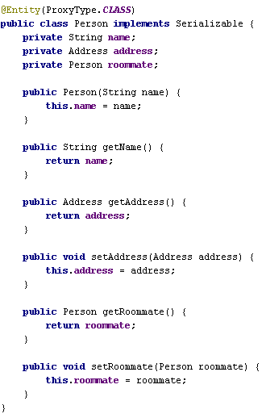
ProxyType.CLASS
- generated proxy extends target class
- all fields must be private
- all methods must be non-final
- the class must be non-final
(- an accessible default constructor is not needed, as the constructor will not be called)
ProxyType.INTERFACE
- generated proxy implements the same interfaces as the target class
- instances of the class must always be used through their interfaces

Slide 38
What happens under the hood when the following is executed?
– with transparent references and garbage collection

Slide 39
Memory
Database

Slide 40
BEGIN TRANSACTION
Memory
Transaction
Database

Slide 41
Person donald = new Person("Donald Duck");
Memory
Transaction
Person
name = “Donald Duck”
Database

Slide 42
donald.setAddress(new Address("Duckburg", "Duck Street 313"));
Memory
Transaction
Person
name = “Donald Duck”
Address
city = “Duckburg”
street = “Duck Street 313”
address
Database

Slide 43
Person mickey = new Person("Mickey Mouse");
Memory
Transaction
Person
name = “Donald Duck”
Address
city = “Duckburg”
street = “Duck Street 313”
address
Person
name = “Mickey Mouse”
Database

Slide 44
mickey.setAddress(donald.getAddress());
Memory
Transaction
Person
name = “Donald Duck”
Address
city = “Duckburg”
street = “Duck Street 313”
address
address
Person
name = “Mickey Mouse”
Database

Slide 45
mickey.setRoommate(donald);
Memory
Transaction
Person
name = “Donald Duck”
Address
city = “Duckburg”
street = “Duck Street 313”
address
roommate
address
Person
name = “Mickey Mouse”
Database

Slide 46
donald.setRoommate(mickey);
Memory
Transaction
Person
name = “Donald Duck”
Address
city = “Duckburg”
street = “Duck Street 313”
address
roommate
roommate
address
Person
name = “Mickey Mouse”
Database

Slide 47
AppContext.getDataManager().setBinding("donald", donald);
Memory
Transaction
id = 1
Person
name = “Donald Duck”
Address
city = “Duckburg”
street = “Duck Street 313”
address
roommate
roommate
address
Person
name = “Mickey Mouse”
Database
id = 1
“donald” = 1

Slide 48
COMMIT TRANSACTION
Memory
Transaction
id = 1
Person
name = “Donald Duck”
Address
city = “Duckburg”
street = “Duck Street 313”
address
roommate
roommate
address
!
Person
name = “Mickey Mouse”
Database
id = 1
“donald” = 1

Slide 49
COMMIT TRANSACTION
Memory
Transaction
id = 1
Person
name = “Donald Duck”
Address
city = “Duckburg”
street = “Duck Street 313”
address
roommate
roommate
address
Person Proxy
ManagedReference
id = 2
id = 2
Person
name = “Mickey Mouse”
Write
Database
Person
name = “Donald Duck”
id = 1
id = 2
Address
city = “Duckburg”
street = “Duck Street 313”
Person Proxy
“donald” = 1
ManagedReference
id = 2

Slide 50
COMMIT TRANSACTION
Memory
Transaction
id = 1
Person
name = “Donald Duck”
Address
city = “Duckburg”
street = “Duck Street 313”
!
address
roommate
roommate
address
Person Proxy
ManagedReference
id = 2
id = 2
Person
name = “Mickey Mouse”
Database
Person
name = “Donald Duck”
id = 1
id = 2
Address
city = “Duckburg”
street = “Duck Street 313”
Person Proxy
“donald” = 1
ManagedReference
id = 2

Slide 51
COMMIT TRANSACTION
Memory
Transaction
id = 1
Person
name = “Donald Duck”
Address
city = “Duckburg”
street = “Duck Street 313”
address
roommate
ManagedReference
id = 1
address
Person Proxy
Person Proxy
roommate
ManagedReference
id = 2
id = 2
Person
name = “Mickey Mouse”
Write
Database
Person
name = “Donald Duck”
id = 1
Person
name = “Mickey Mouse”
id = 2
Address
city = “Duckburg”
street = “Duck Street 313”
Address
city = “Duckburg”
street = “Duck Street 313”
Person Proxy
“donald” = 1
Person Proxy
ManagedReference
id = 2
ManagedReference
id = 1

Slide 52
Memory
Person
name = “Donald Duck”
Address
city = “Duckburg”
street = “Duck Street 313”
address
roommate
ManagedReference
id = 1
address
Person Proxy
Person Proxy
roommate
ManagedReference
id = 2
Person
name = “Mickey Mouse”
Database
Person
name = “Donald Duck”
id = 1
Person
name = “Mickey Mouse”
id = 2
Address
city = “Duckburg”
street = “Duck Street 313”
Address
city = “Duckburg”
street = “Duck Street 313”
Person Proxy
“donald” = 1
Person Proxy
ManagedReference
id = 2
ManagedReference
id = 1

Slide 53
Memory
Database
Person
name = “Donald Duck”
id = 1
Person
name = “Mickey Mouse”
id = 2
Address
city = “Duckburg”
street = “Duck Street 313”
Address
city = “Duckburg”
street = “Duck Street 313”
Person Proxy
“donald” = 1
Person Proxy
ManagedReference
id = 2
ManagedReference
id = 1

Slide 54
Memory
Database
Person
name = “Donald Duck”
id = 1
Person
name = “Mickey Mouse”
id = 2
Address
city = “Duckburg”
street = “Duck Street 313”
Address
city = “Duckburg”
street = “Duck Street 313”
Person Proxy
“donald” = 1
Person Proxy
ManagedReference
id = 2
ManagedReference
id = 1

Slide 55
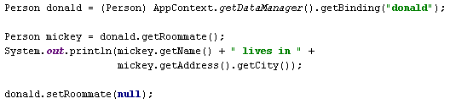
What happens under the hood when the following is executed?
– with transparent references and garbage collection

Slide 56
Memory
Database
Person
name = “Donald Duck”
id = 1
Person
name = “Mickey Mouse”
id = 2
Address
city = “Duckburg”
street = “Duck Street 313”
Address
city = “Duckburg”
street = “Duck Street 313”
Person Proxy
“donald” = 1
Person Proxy
ManagedReference
id = 2
ManagedReference
id = 1

Slide 57
BEGIN TRANSACTION
Memory
Transaction
Database
Person
name = “Donald Duck”
id = 1
Person
name = “Mickey Mouse”
id = 2
Address
city = “Duckburg”
street = “Duck Street 313”
Address
city = “Duckburg”
street = “Duck Street 313”
Person Proxy
“donald” = 1
Person Proxy
ManagedReference
id = 2
ManagedReference
id = 1

Slide 58
Person donald = (Person) AppContext.getDataManager().getBinding("donald");
Memory
Transaction
id = 1
Address
city = “Duckburg”
street = “Duck Street 313”
Person
name = “Donald Duck”
address
roommate
Person Proxy
ManagedReference
id = 2
Load
Database
Person
name = “Donald Duck”
id = 1
Person
name = “Mickey Mouse”
id = 2
Address
city = “Duckburg”
street = “Duck Street 313”
Address
city = “Duckburg”
street = “Duck Street 313”
Person Proxy
“donald” = 1
Person Proxy
ManagedReference
id = 2
ManagedReference
id = 1

Slide 59
Person mickey = donald.getRoommate();
Memory
Transaction
id = 1
Address
city = “Duckburg”
street = “Duck Street 313”
Person
name = “Donald Duck”
address
roommate
Person Proxy
ManagedReference
id = 2
Database
Person
name = “Donald Duck”
id = 1
Person
name = “Mickey Mouse”
id = 2
Address
city = “Duckburg”
street = “Duck Street 313”
Address
city = “Duckburg”
street = “Duck Street 313”
Person Proxy
“donald” = 1
Person Proxy
ManagedReference
id = 2
ManagedReference
id = 1

Slide 60
System.out.println(mickey.getName() + " lives in " +
mickey.getAddress().getCity());
Memory
Transaction
id = 1
Address
city = “Duckburg”
street = “Duck Street 313”
Person
name = “Donald Duck”
address
roommate
ManagedReference
id = 1
Address
city = “Duckburg”
street = “Duck Street 313”
Person Proxy
Person Proxy
address
roommate
ManagedReference
id = 2
id = 2
Person
name = “Mickey Mouse”
Load
Database
Person
name = “Donald Duck”
id = 1
Person
name = “Mickey Mouse”
id = 2
Address
city = “Duckburg”
street = “Duck Street 313”
Address
city = “Duckburg”
street = “Duck Street 313”
Person Proxy
“donald” = 1
Person Proxy
ManagedReference
id = 2
ManagedReference
id = 1

Slide 61
donald.setRoommate(null);
Memory
Transaction
id = 1
Address
city = “Duckburg”
street = “Duck Street 313”
Person
name = “Donald Duck”
address
ManagedReference
id = 1
Address
city = “Duckburg”
street = “Duck Street 313”
Person Proxy
Person Proxy
address
roommate
ManagedReference
id = 2
id = 2
Person
name = “Mickey Mouse”
Database
Person
name = “Donald Duck”
id = 1
Person
name = “Mickey Mouse”
id = 2
Address
city = “Duckburg”
street = “Duck Street 313”
Address
city = “Duckburg”
street = “Duck Street 313”
Person Proxy
“donald” = 1
Person Proxy
ManagedReference
id = 2
ManagedReference
id = 1

Slide 62
COMMIT TRANSACTION
Memory
Transaction
id = 1
Address
city = “Duckburg”
street = “Duck Street 313”
Person
name = “Donald Duck”
address
Write
ManagedReference
id = 1
Address
city = “Duckburg”
street = “Duck Street 313”
Person Proxy
Person Proxy
address
roommate
ManagedReference
id = 2
id = 2
Person
name = “Mickey Mouse”
Database
Person
name = “Donald Duck”
id = 1
Person
name = “Mickey Mouse”
id = 2
Address
city = “Duckburg”
street = “Duck Street 313”
Address
city = “Duckburg”
street = “Duck Street 313”
“donald” = 1
Person Proxy
ManagedReference
id = 1

Slide 63
COMMIT TRANSACTION
Memory
Transaction
id = 1
Address
city = “Duckburg”
street = “Duck Street 313”
Person
name = “Donald Duck”
address
ManagedReference
id = 1
Address
city = “Duckburg”
street = “Duck Street 313”
Person Proxy
Person Proxy
address
roommate
ManagedReference
id = 2
id = 2
Person
name = “Mickey Mouse”
Not Modified
Database
Person
name = “Donald Duck”
id = 1
Person
name = “Mickey Mouse”
id = 2
Address
city = “Duckburg”
street = “Duck Street 313”
Address
city = “Duckburg”
street = “Duck Street 313”
“donald” = 1
Person Proxy
ManagedReference
id = 1

Slide 64
Memory
Address
city = “Duckburg”
street = “Duck Street 313”
Person
name = “Donald Duck”
address
ManagedReference
id = 1
Address
city = “Duckburg”
street = “Duck Street 313”
Person Proxy
Person Proxy
address
roommate
ManagedReference
id = 2
Person
name = “Mickey Mouse”
Database
Person
name = “Donald Duck”
id = 1
Person
name = “Mickey Mouse”
id = 2
Address
city = “Duckburg”
street = “Duck Street 313”
Address
city = “Duckburg”
street = “Duck Street 313”
“donald” = 1
Person Proxy
ManagedReference
id = 1

Slide 65
Memory
Database
Person
name = “Donald Duck”
id = 1
Person
name = “Mickey Mouse”
id = 2
Address
city = “Duckburg”
street = “Duck Street 313”
Address
city = “Duckburg”
street = “Duck Street 313”
“donald” = 1
Person Proxy
ManagedReference
id = 1

Slide 66
Memory
Database
Person
name = “Donald Duck”
id = 1
Person
name = “Mickey Mouse”
id = 2
Address
city = “Duckburg”
street = “Duck Street 313”
Address
city = “Duckburg”
street = “Duck Street 313”
“donald” = 1
Person Proxy
ManagedReference
id = 1

Slide 67

Memory
Database
Person
name = “Donald Duck”
id = 1
Person
name = “Mickey Mouse”
id = 2
Address
city = “Duckburg”
street = “Duck Street 313”
Address
city = “Duckburg”
street = “Duck Street 313”
“donald” = 1
Person Proxy
ManagedReference
id = 1

Slide 68
Memory
Database
Person
name = “Donald Duck”
id = 1
Address
city = “Duckburg”
street = “Duck Street 313”
“donald” = 1

Slide 69
Memory
Database
Person
name = “Donald Duck”
id = 1
Address
city = “Duckburg”
street = “Duck Street 313”
“donald” = 1

Slide 70
Agenda
How Darkstar's persistence model is currently?
How transparent references and garbage collection change the persistence model?
Future directions

Slide 71
Future directions
Include transparent references in the official Project Darkstar Server distribution
Areas which need more work
  Scalability of the multi-node version
  Improved garbage collector, multi-node support, alternative algorithms, reference counting vs. tracing collectors
  Refactoring serialized data, rolling upgrades
  Indexing and querying the database
  ...
It's all open source!

Slide 72
Questions?
Project Darkstar Community
– official web site, discussion forums
http://www.projectdarkstar.com/
Darkstar EXP
– unofficial distribution of Darkstar Server with experimental features, includes transparent references and garbage collector
http://code.google.com/p/darkstar-exp/
Dimdwarf Application Server
– same transparent reference implementation, alternative server implementation, primarily designed for embedded standalone mode
http://dimdwarf.sourceforge.net/

